Slide 1

Kung Fu Hamster
Next version of Scholarship Universe Engine High Level Overview

Slide 2
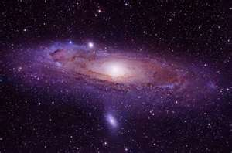
Overview
What isn’t working and why
What we will do to fix it
New things we can do!
What that means for the interface
What that means for the future

Slide 3

Everything is a requirement
Current version creates logic and navigational items through requirements
Some items entered as requirements such as Essay which are not requirements
Scholarships without requirement require a second more expensive query

Slide 4
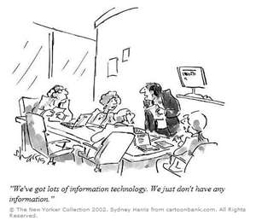

Lots of data
Current structure needs to have a row per student and attribute
Need answer for every attribute to run query
The student attributes is approaching 3 million records

Slide 5

Limited logic
Currently only has gate logic
Gate logic is difficult to program
Gate logic causes query to run much slower

Slide 6
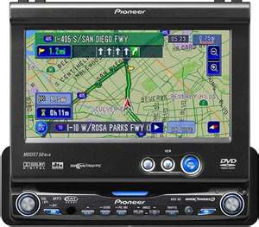
Navigational topics expensive
Using “is in” operator is necessary for some queries
Taxes the database or logic engine
Less efficient

Slide 7


New concepts
Navigational Items
The old interests
Topics- General, Social Science, Education , etc.
Sub-Topics-based on topics
Checkbox Items
Resume
Essay
Transcript
Application
Other documents

Slide 8

More new ideas
Application Fields
Fields needed by customer
Required or not required
Documents uploaded
Allows application interface
Multiple attributes for one scholarship allowed

Slide 9

Lots of data
Now one row per student
Go from over 2.5 million down to < 30K
Managed by application, not database
No more “fake” requirements such as topics
Topics makes faster query due to less data
No more secondary queries for scholarships without requirements
Moving scholarship info into package info
Easier to archive

Slide 10

New improved logic
New Clause concepts
AND Clause
All must return true for positive
OR Clause
Any must return true for positive
COMPLEX Clause
(A&B) or C
(Major=Science and Major=Biology) or Major=Biological Engineering

Slide 11
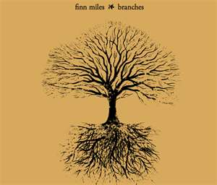
Branches
Allows IF /ELSE Statements
Allows When statements
When student =UGRAD
Requirements for UGRAD
When student=GRAD
Requirements for GRAD
Wizards for common items

Slide 12

Checklists part of package
No longer a requirement
Well defined
Different from Fields
Fields are related to attributes
Attributes have a field/requirement radio button

Slide 13
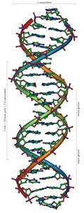
Structure
Scholarship
Description
Dates
Checklists
Requirements
CLAUSES
Topics/SubTopics
Application Fields-Only for internal
Fields with order
Owners-only for internal

Slide 14
Visual Structure
Scholarships
Dates
Descriptions
Checklists
One to Many Items
Fields
Requirements
SubTopics
Owners
Topic
Clauses
Branches
Ordered
Attributes
Attributes

Slide 15
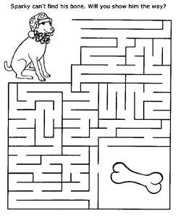
All packages must have topic(s)
Must have general topic
If not specific->General
Allows user to get rid of scholarships with lots of applicants
Topics should not change
But if do, we now can identify this
Subtopics have parent of a topic

Slide 16

Every requirement is in a clause
AND Clause is the default
(you won’t see it but it is there)
Just keep adding to default
If you need an OR, start with clause
If you have UGRAD/GRAD split use a branch
Will have wizards for easy entry

Slide 17
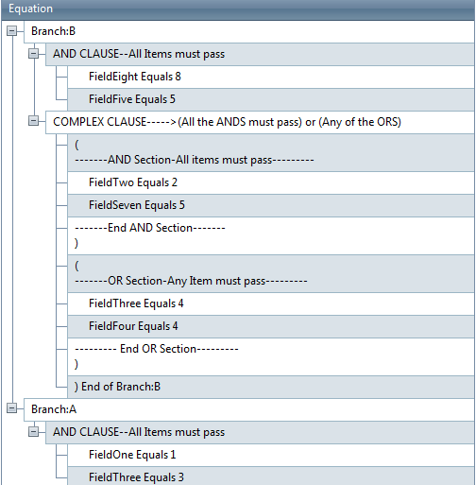
Requirement Structure

Slide 18
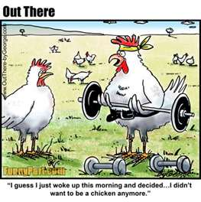
No longer attributes
Navigation Topics are separate now
These will be migrated in the conversion
I will analyze these to get most bang for buck
There will now be a Topic list like attributes
Checklist items are also no longer attributes
Fields are separate section only for internal

Slide 19
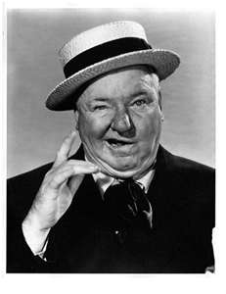
W.C. Fields
Fields are items that will appear for internal scholarships
Will allow sort order for application feel
Based on attributes
Attributes will now have “field only” flag
For example, Attach Essay and other checklist items
Allow branches for if/then logic

Slide 20


There’s an app for that
New monodevelop software
Allows to keep same “engine” for all versions
iPhone and Android versions
Lilliputian scaling
New format allows departments to have custom application
Order
Could use branches for if/then logic on application

Slide 21

Migration
Need to migrate data to new format
Then develop application and test in new format
Will be a long process
But will be worth it because app will be able to scale and create any type of custom logic

Slide 22
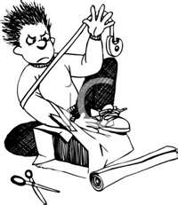
So to wrap it up
Scholarship Universe will be going through major surgery changing it’s internal structure
Will move general attributes into different categories
Topics
Sub Topics
Checklists
Fields

Slide 23

And don’t forget
Changing student data for ultimate scalability
Changing logic to handle any type
AND
OR
COMPLEX
And allowing branches to split application types
It will be a lot of work
But worth it

Slide 24

Thus ends the legend of the Kung Fu Hamster

